Slide 1

Churn Prediction

Slide 2
Overview:
Churn quantifies the number of customers who have unsubscribed or canceled their service contract.
Churn is a one of the biggest problem in the telecom industry.

Slide 3
Data Exploration
Dataset Shape
3333 observations with 21 features.
No Null values
No duplicates

Slide 4
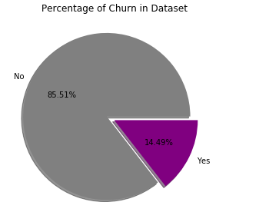
Target Feature – Churn
From given data, 14.49% of total number of customer churn.

Slide 5
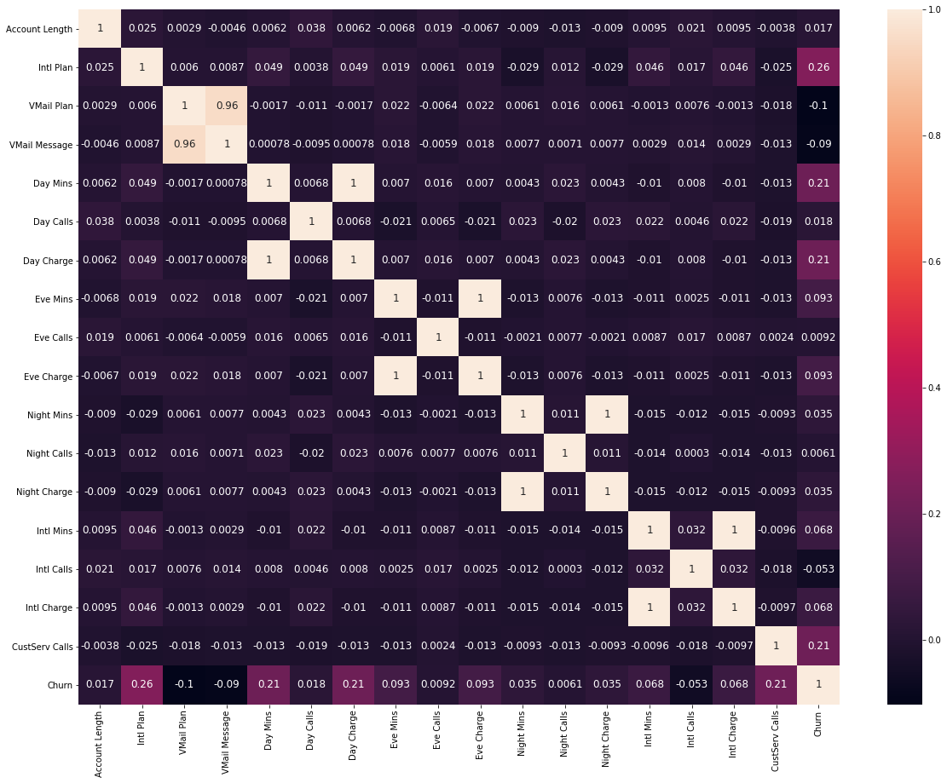
Correlation values

Slide 6
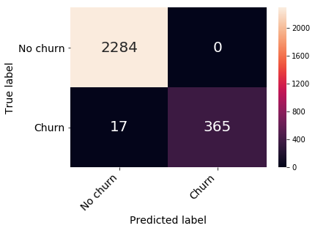
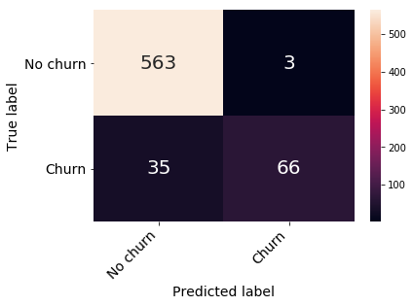
Logistic Regression
Train Data
Test Data
Confusion Matrix
Confusion Matrix

Slide 7
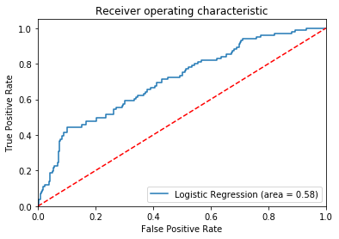
Logistic Regression – contd.
Train Data
Accuracy – 86.64 %
ROC AUC Curve (Test Data)
Test Data
Accuracy – 85 %

Slide 8
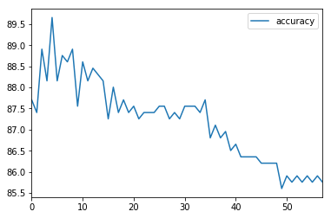
KNN
The Accuracy value is 89.65517241379311 with k= 5
Optimal K value,
sqrt(no of observations) is 58.
High Accuracy at k=5.

Slide 9

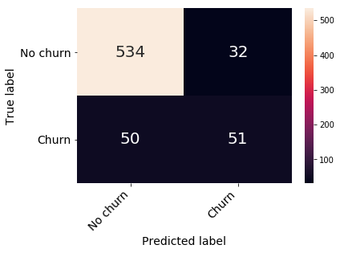
KNN – contd.
Train Data
Test Data
Confusion Matrix
Confusion Matrix

Slide 10
KNN – contd.
Train Data
Test Data
Accuracy – 92.16%
Accuracy – 89.65 %

Slide 11
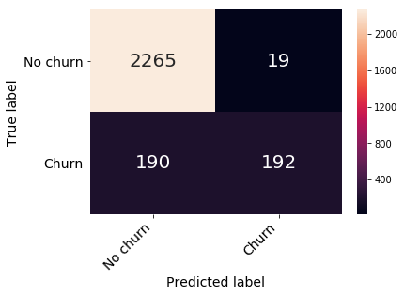
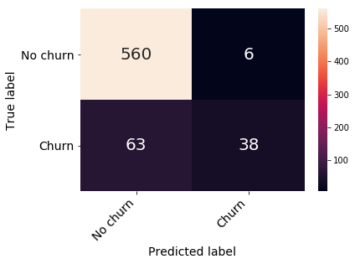
Naïve Bayes
Train Data
Test Data
Confusion Matrix
Confusion Matrix

Slide 12
Naïve Bayes – contd..
Train Data
Test Data
Accuracy – 86.68%
Accuracy – 85.45%

Slide 13
Decision Tree
Better parameter values after Tuning.
fit_predict(X_train, X_test, y_train, y_test, StandardScaler(), 9, max_features=0.5, min_samples_split=4, criterion = 'entropy')

Slide 14
Decision Tree– contd..
Train Data
Test Data
Accuracy – 97.63%
Accuracy – 93.70%

Slide 15
Random Forest
After performing Gridsearch CV,
best_params_ are
{'bootstrap': True, 'max_features': 0.4, 'min_samples_leaf': 1, 'n_estimators': 15}

Slide 16
Random Forest– contd..
Train Data
Test Data
Accuracy – 99.77%
Accuracy : 95.35%

Slide 17
Boosting - ADABOOST
Train Data
Test Data
Accuracy :90.28%
Accuracy : 87.40 %

Slide 18
Boosting - GradientBoost
Train Data
Test Data
Accuracy :100%
Accuracy : 92.95 %

Slide 19
Boosting - XGBoost
Train Data
Test Data
Accuracy :
Accuracy :

